Slide 1

Title: Obesity Population of Adults in Malaysia
SECTION 1 (GROUP A)
Nurshahidah Irdina Binti Shamharir (1912296)
Intan Amirah Binti Rosre (1918692)
Nurul Balqis Amyli Binti Yaacob (1915472)
Irdina Hidayah Binti Khairudin (1916514)

Slide 2
OBJECTIVES
Calculate and predict the percentage of Malaysian adults who are obese and not obese by age groups (18-24, 25-44, 45-64, 65+).
Determine the constant percentage rate (equilibrium vector) of the population if any.
Indicate the average age an adult should pay extra attention to their weight gain.
01
02
03

Slide 3
RELATED WORK REVIEW
Markov Chain Model Development for Forecasting Air Pollution Index of Miri, Sarawak
Use Markov Model to predict the air pollution index (API) for the long term.
The initial state vector and state transition probability were used in predicting the (API) that has been acquired from the observed frequency for one state shift to another.
Air quality status involved: good, moderate, unhealthy, very unhealthy and hazardous.
Has low ow RMSE and MAPE value of 0.5330 and 0.1979 percent, indicating that it has a high accuracy in prediction.
Can help government to warn people to prepare themselves before any hazardous scenario.

Slide 4
METHODOLOGY(PART 1)
Linear Algebra Technique
Markov Chain technique is used for this project to predict the percentage of adults who may or may not be obese in the future.
We will calculate the chances of obese adults who may remain obese or not within every 5 years and in the far future.
Calculation will be done according to age groups (18-24, 25-44, 45-64, 65+), producing 4 markov chains.
By comparing results of all 4 markov chains, we could find the age group with the highest probability of becoming and/or remain obese quicker.
Finding the steady states (if any) will also contribute in identifying the best time to be more attentive on weight gain and lifestyle.

Slide 5
METHODOLOGY(PART 2)
Eigenvalues Dynamical System Technique
Eigenvalue Dynamical System Technique is used for this project to predict the eventual population of obese and non-obese people in the future..
We will construct the stage-matrix by age groups (18-24, 25-44, 45-64, 65+) of obese and non-obese adults based on the change in growth rate from 2011 to 2015.
Eigenvalues and eigenvectors obtained from the respective stage-matrices will be used to build the general solution of the population at a given year.
From the general solution, the estimated eventual ratio of obese to non-obese people in the far future can be calculated.
By comparing the results of all eventual ratios, we could find the age group with the highest probability of obese population over non-obese.

Slide 6
METHODOLOGY(PART 3)
Data Collection
Proportion of Obese Malaysian Adults in 2011 and 2015 from the Department of Statistics Malaysia Official Open Data Portal
Data Format
The dataset consists the percentage of obese adults proportion by sex, state and age group in the years 2011 and 2015. This includes:
The proportion of obese adults in all of Malaysia by age group.
The proportion of obese adults among women by age group.
The proportion of obese adults among men by age group
The proportion of obese men and women by each state and age group.

Slide 7
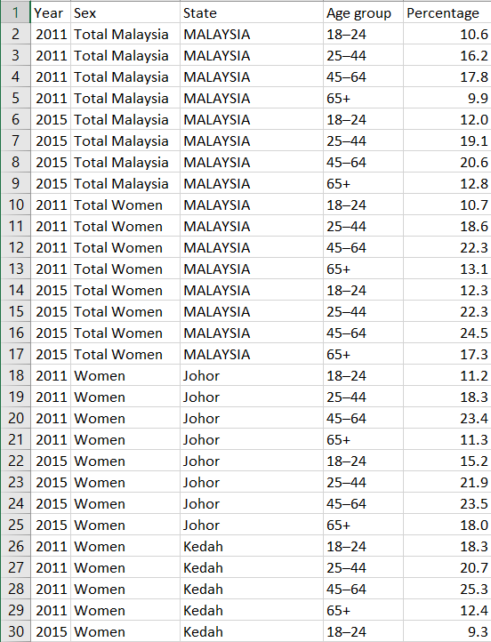
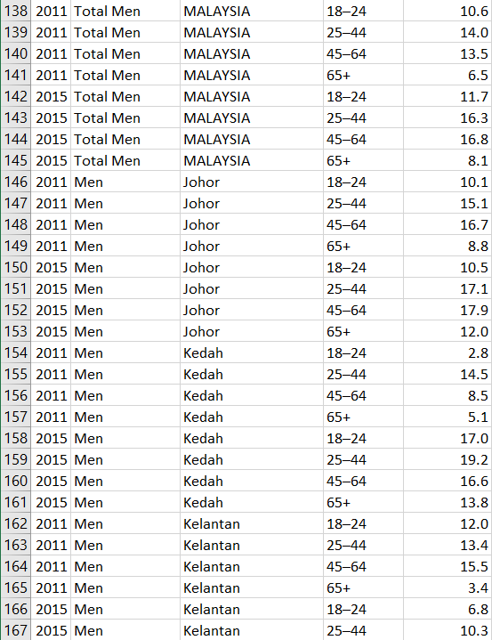
SAMPLE FROM DATASET
total no. of rows: 264

Slide 8
EXPECTED OUTCOMES
01
02
03
The rate of obese and non-obese adults in Malaysia.
The probable total population by age group of obese Malaysian adults in future years.
The long-term probability (steady state) of each age group remaining in the state they are in (if any).

Slide 9
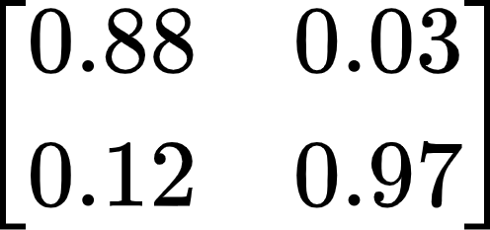
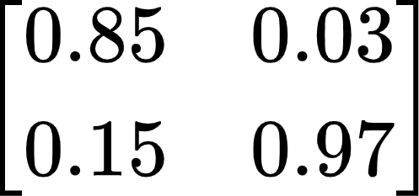
MARKOV CHAIN
Transition Matrix: Age group 18-24 =
 | Obese | Not Obese
Obese | 0.88 | 0.03
Not Obese | 0.12 | 0.97
Transition Matrix: Age group 25-44 =
 | Obese | Not Obese
Obese | 0.85 | 0.03
Not Obese | 0.15 | 0.97

Slide 10
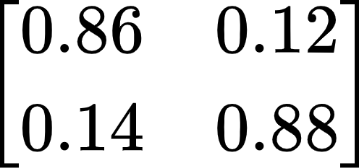
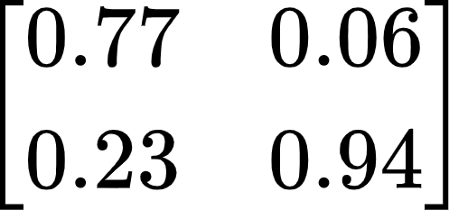
MARKOV CHAIN
Transition Matrix: Age group 45-64 =
 | Obese | Not Obese
Obese | 0.86 | 0.12
Not Obese | 0.14 | 0.88
Transition Matrix: Age group 65+ =
 | Obese | Not Obese
Obese | 0.77 | 0.06
Not Obese | 0.23 | 0.94

Slide 11
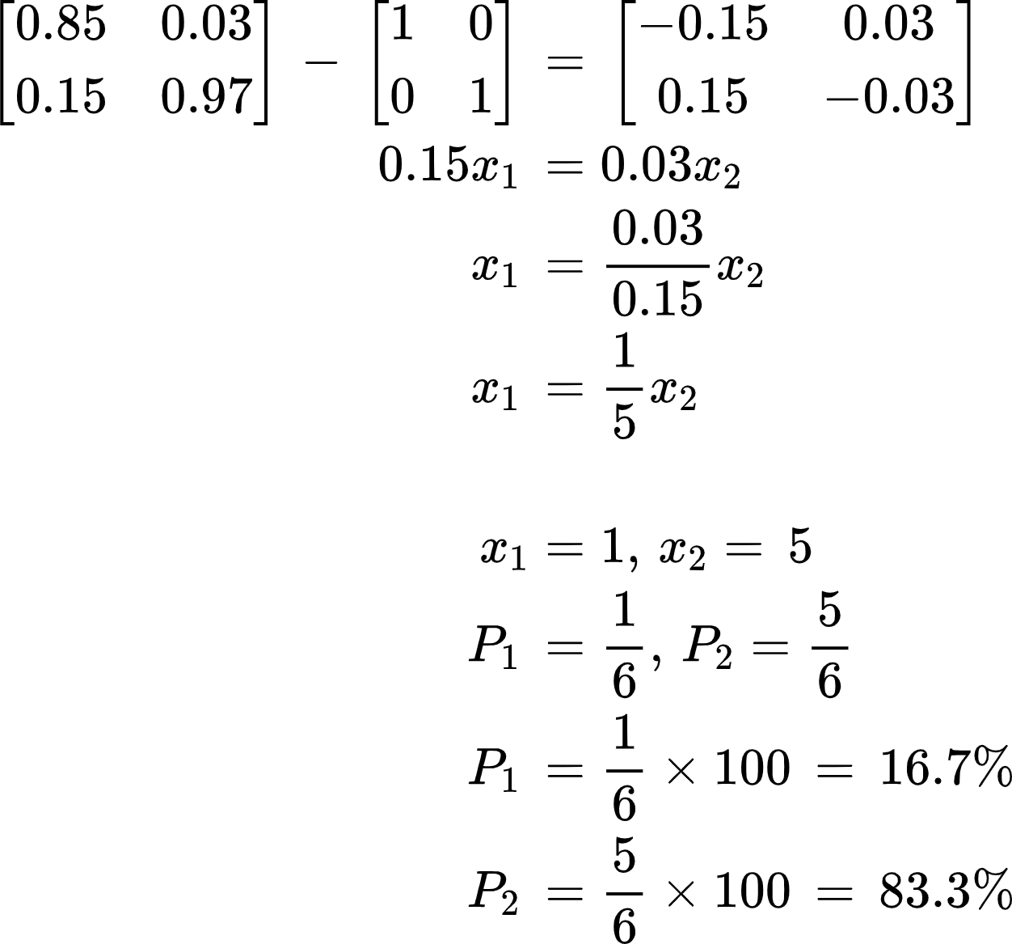
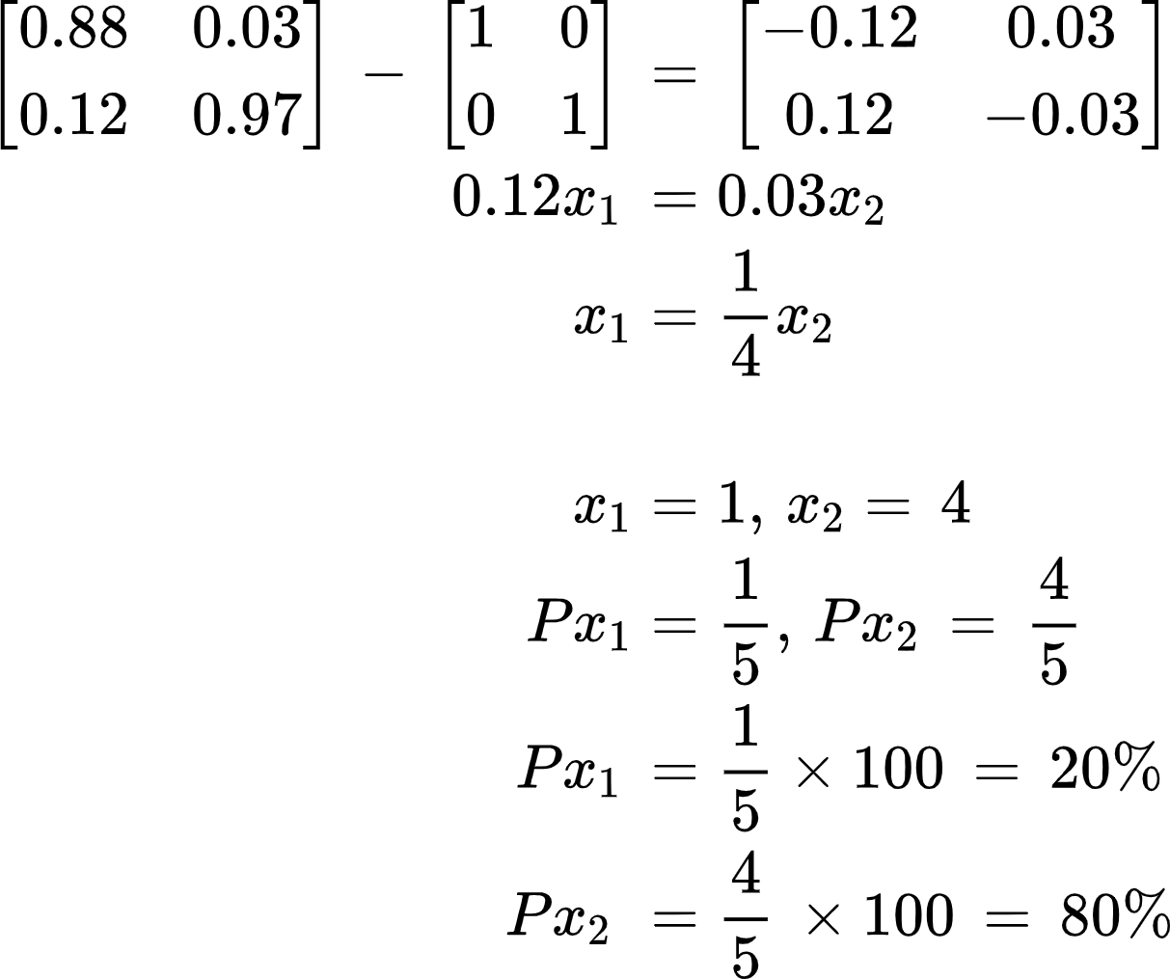
STEADY - STATE
Age group 18-24 =
Age group 25-44 =
Obese
Not Obese
Obese
Not Obese

Slide 12
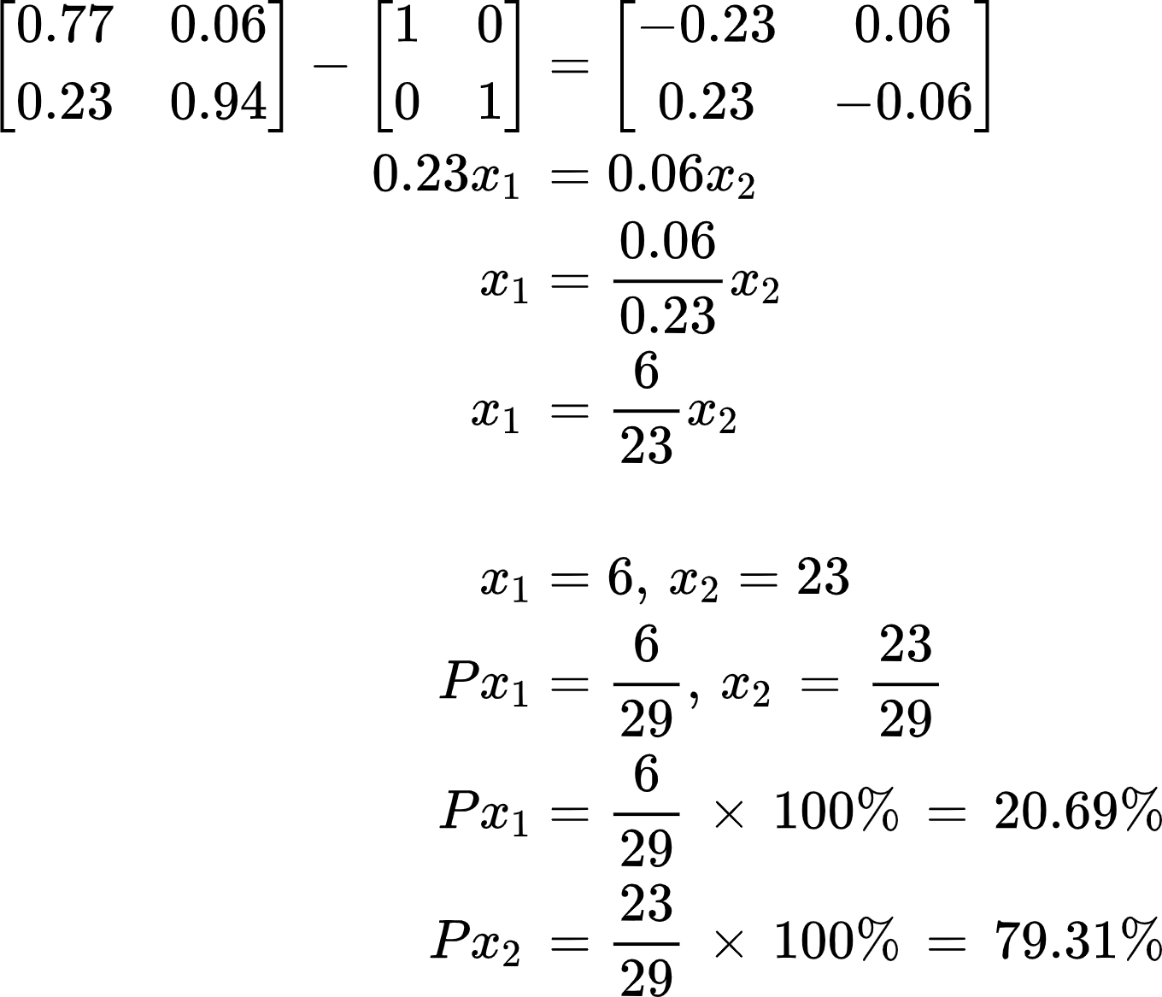
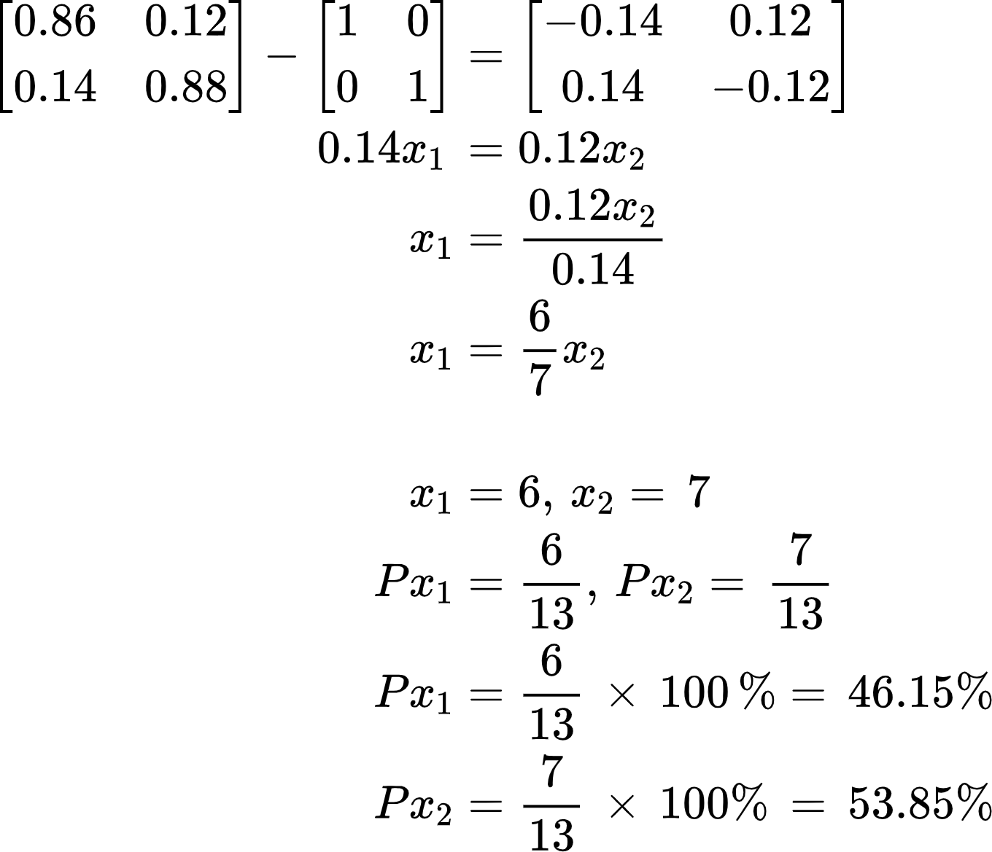
STEADY - STATE
Age group 45-64 =
Age group 65+ =
Obese
Not Obese
Obese
Not Obese

Slide 13
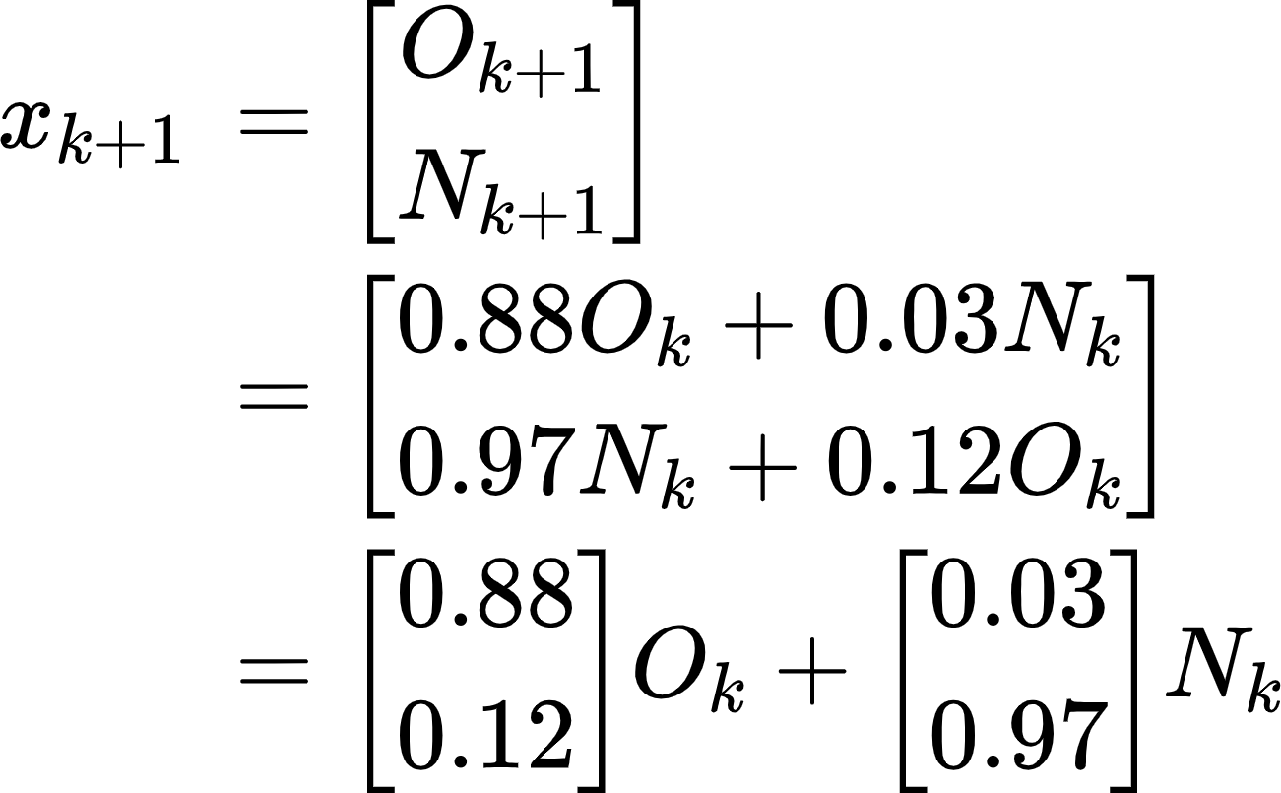
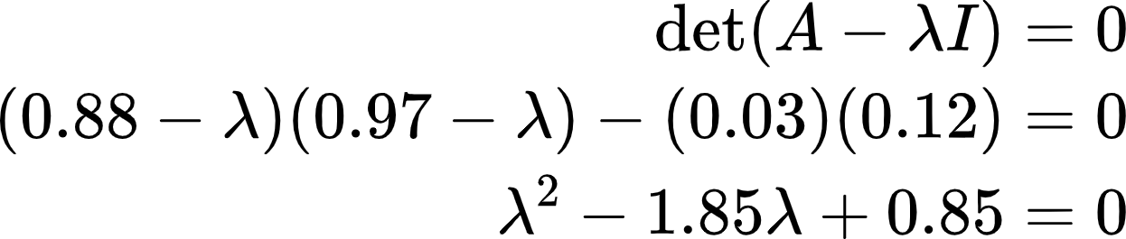
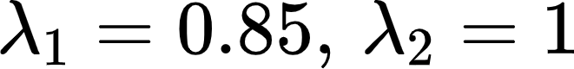
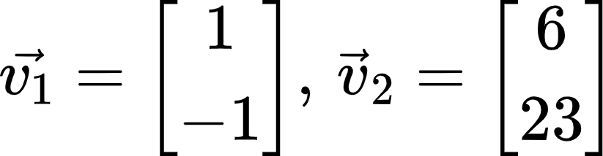
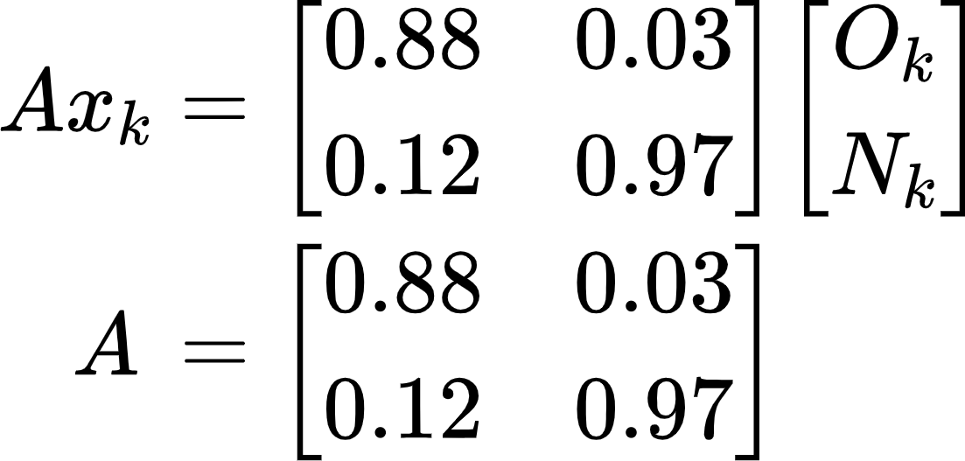
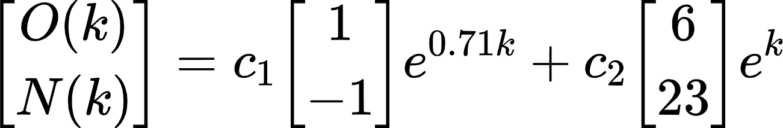
General Solutions and Eventual Ratios
Dynamic System: Age group 18-24
88% remain obese, and 3% non-obese became obese the following year.
97% remain non-obese, and 12% obese became non-obese the following year.
General Solution:
Eigenvalues:
Eigenvectors:
for k >= 0

Slide 14
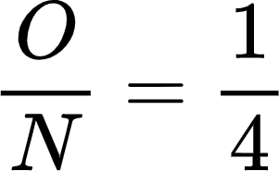
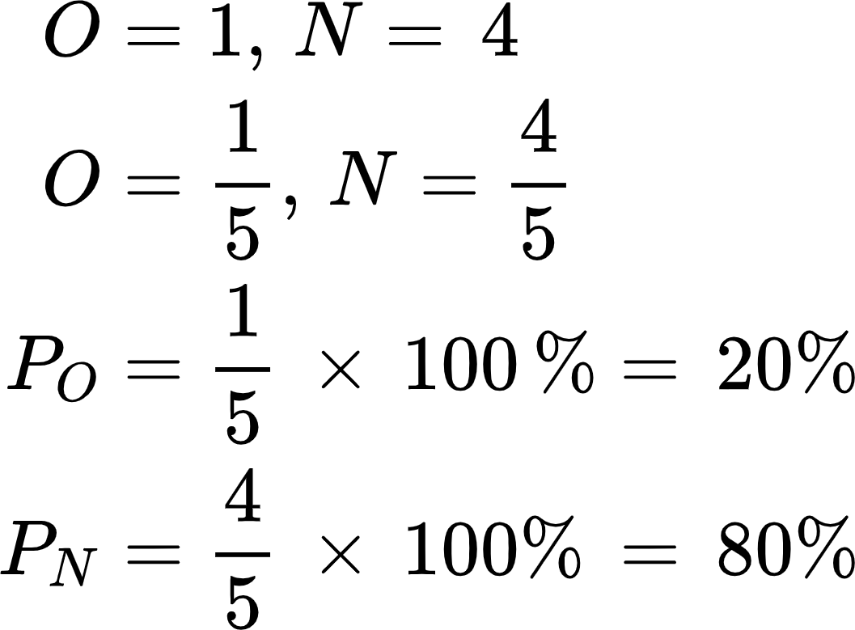
General Solutions and Eventual Ratios
Dynamic System: Age group 18-24
Eventual ratio of obese to non-obese people:
as k→∞,
for every obese person, there are about 4 non-obese people.

Slide 15
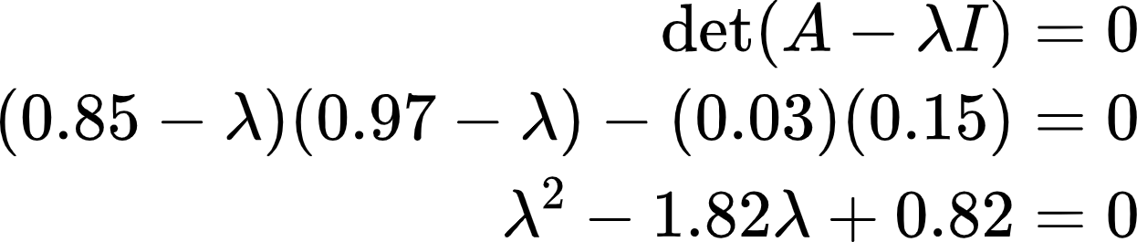
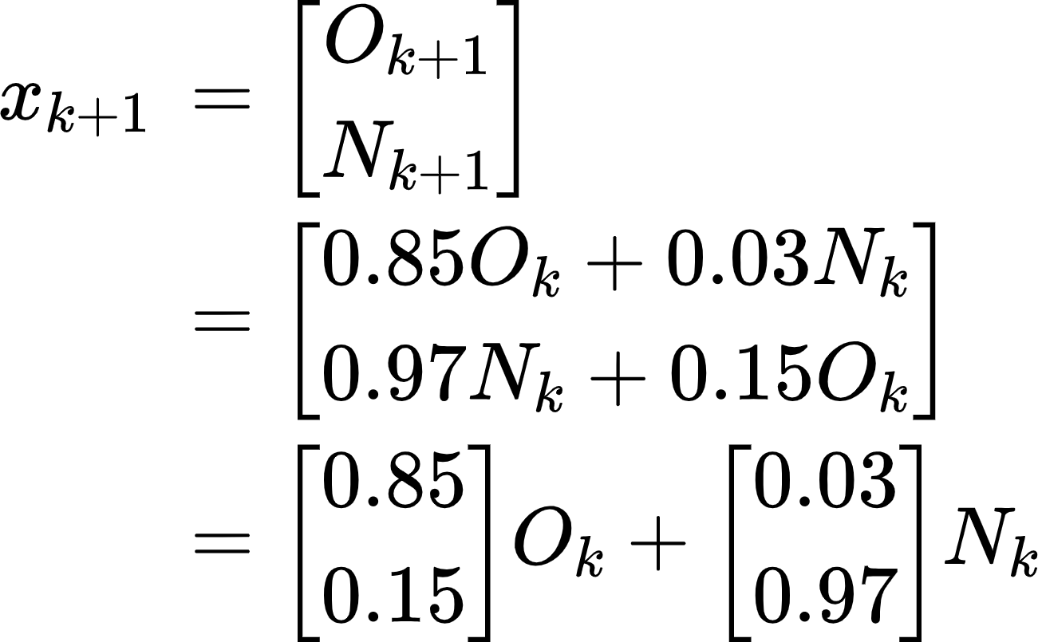
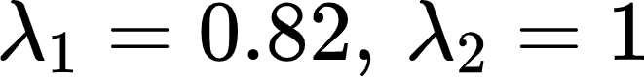
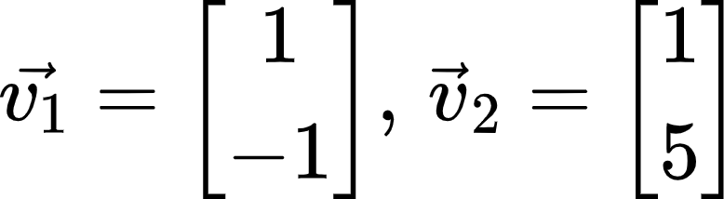
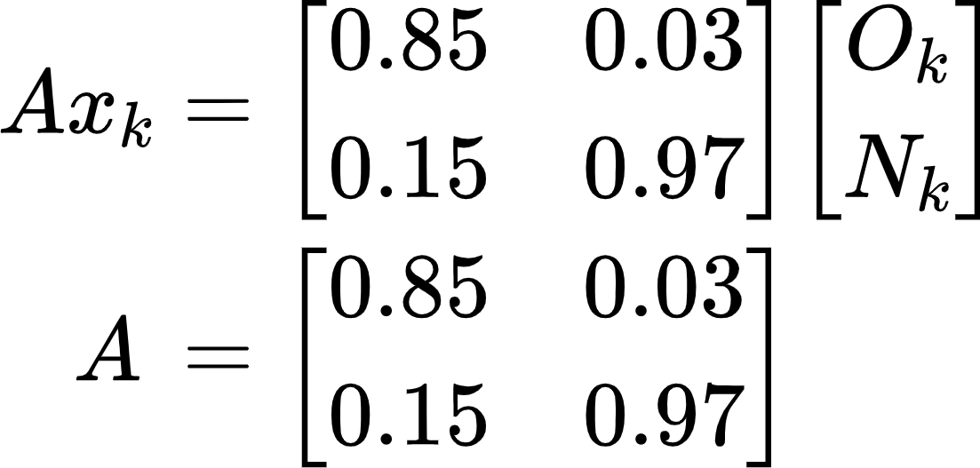
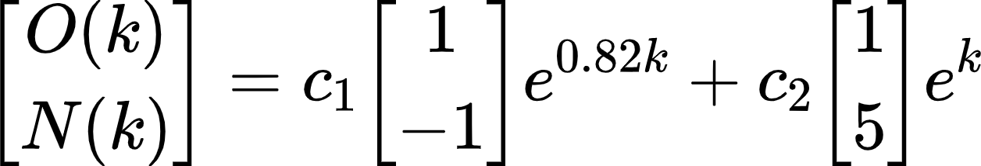
General Solutions and Eventual Ratios
Dynamic System: Age group 25-44
85% remain obese, and 3% non-obese became obese the following year.
97% remain non-obese, and 15% obese became non-obese the following year.
General Solution:
Eigenvalues:
Eigenvectors:
for k >= 0

Slide 16
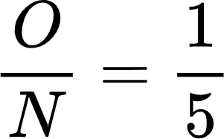
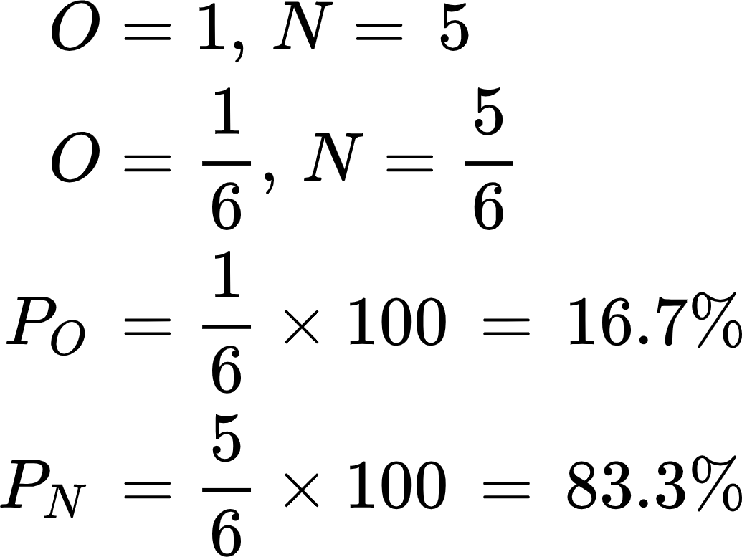
General Solutions and Eventual Ratios
Dynamic System: Age group 25-44
Eventual ratio of obese to non-obese people:
as k→∞,
for every obese person, there are about 5 non-obese people.

Slide 17
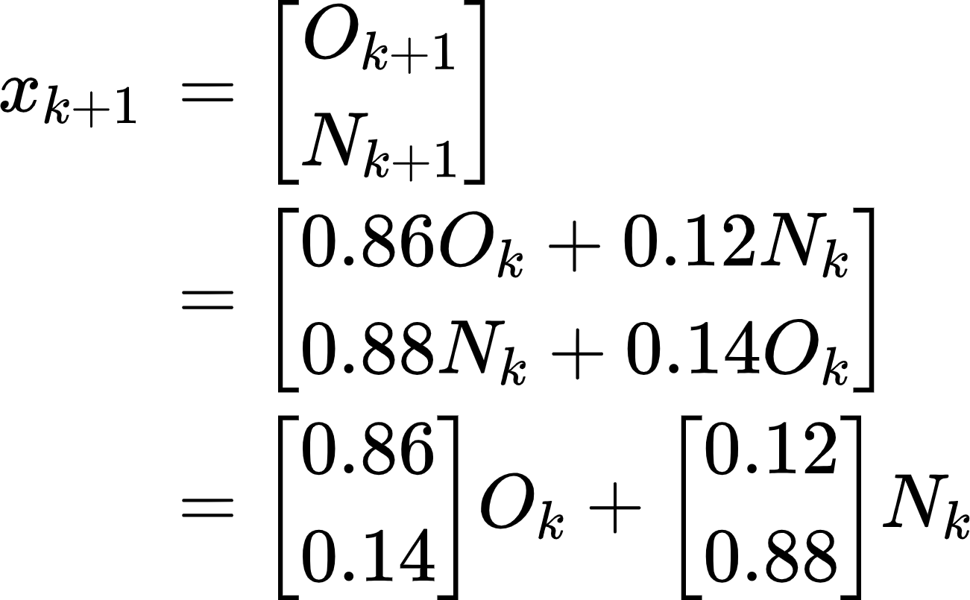
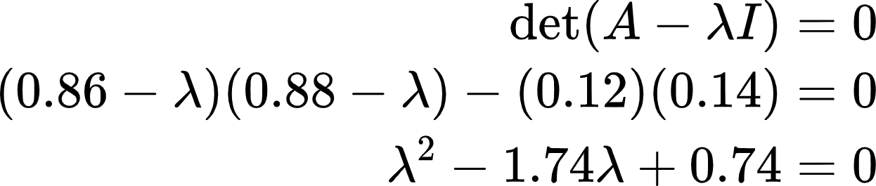
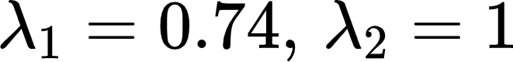
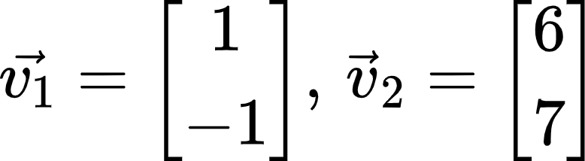
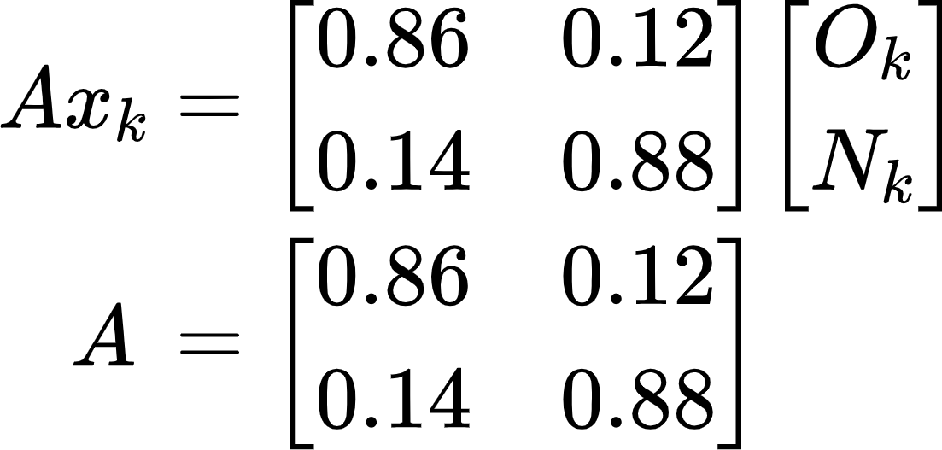
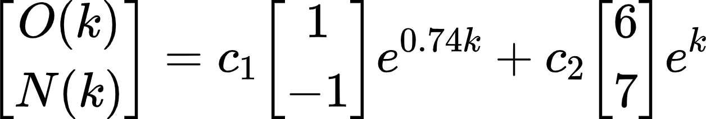
General Solutions and Eventual Ratios
Dynamic System: Age group 45-64
86% remain obese, and 12% non-obese became obese the following year.
88% remain non-obese, and 14% obese became non-obese the following year.
General Solution:
Eigenvalues:
Eigenvectors:
for k >= 0

Slide 18
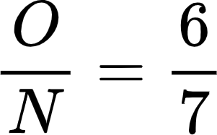
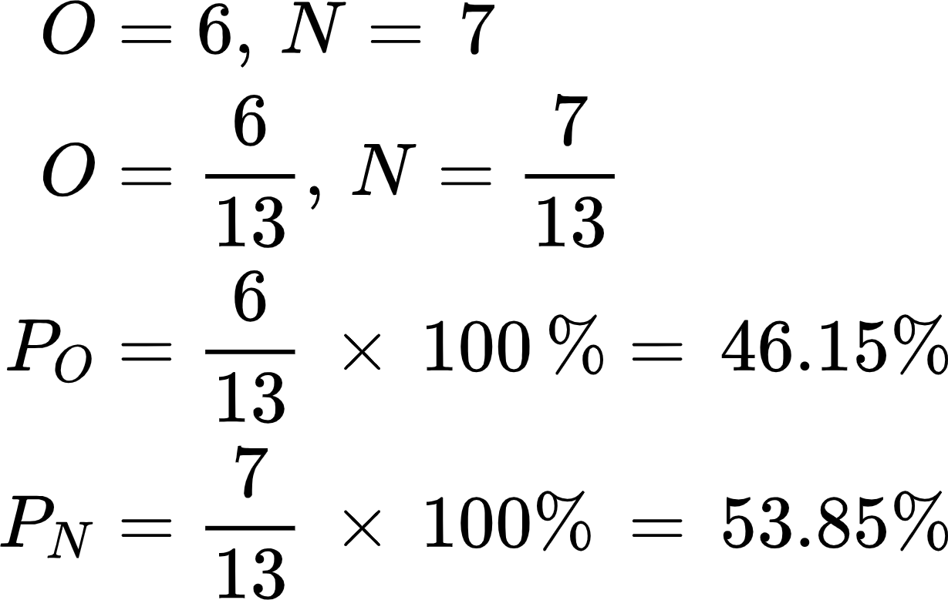
General Solutions and Eventual Ratios
Dynamic System: Age group 45-64
Eventual ratio of obese to non-obese people:
as k→∞,
for every 6 obese people, there are about 7 non-obese people.

Slide 19
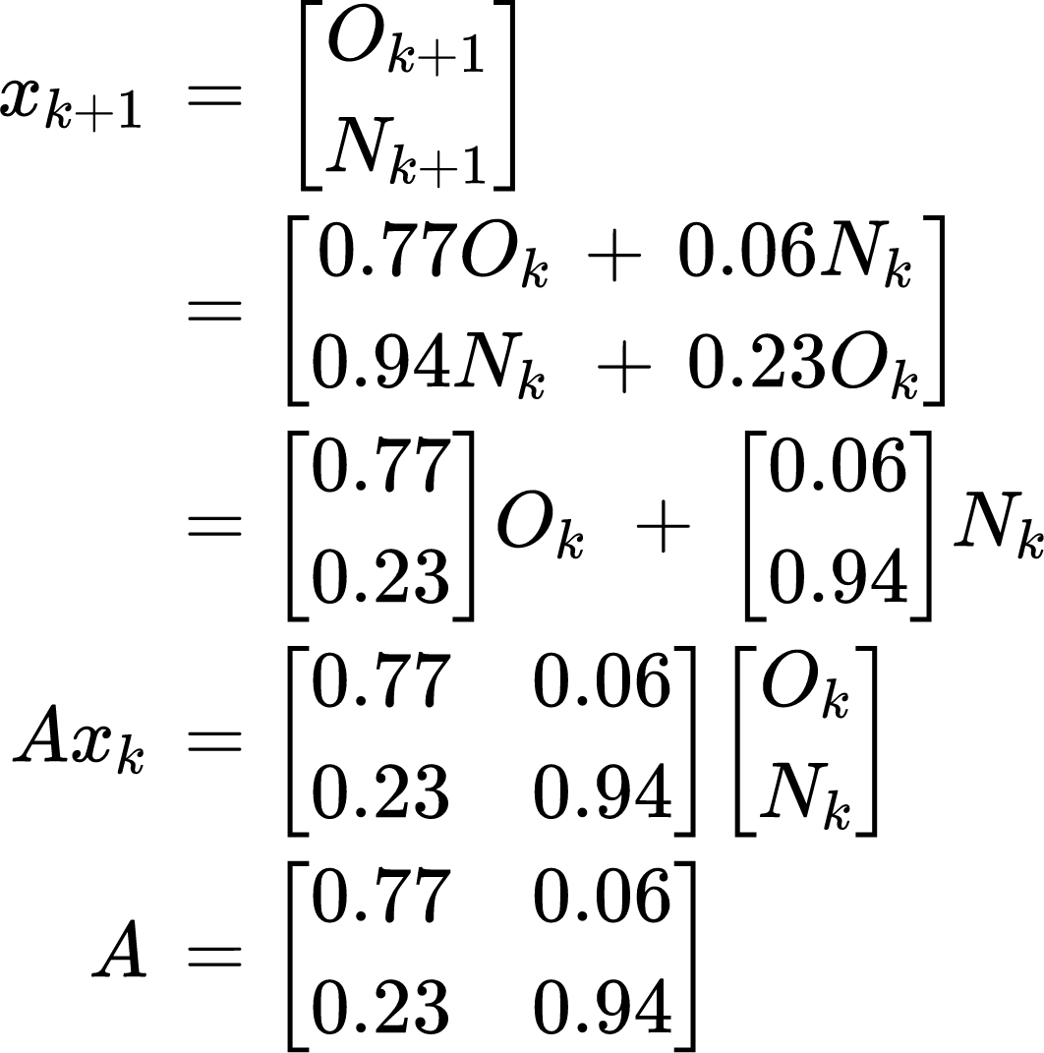
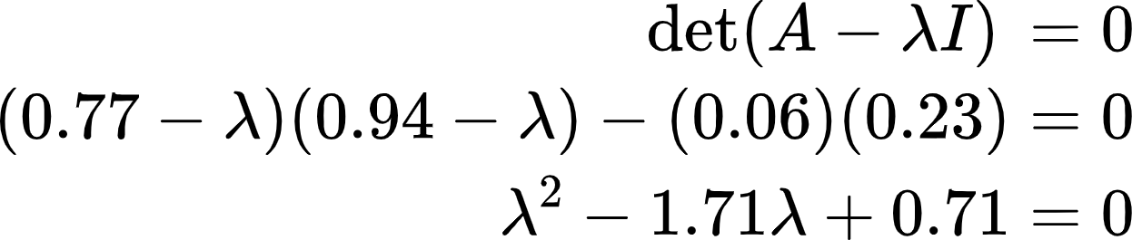
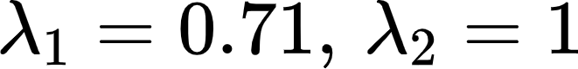
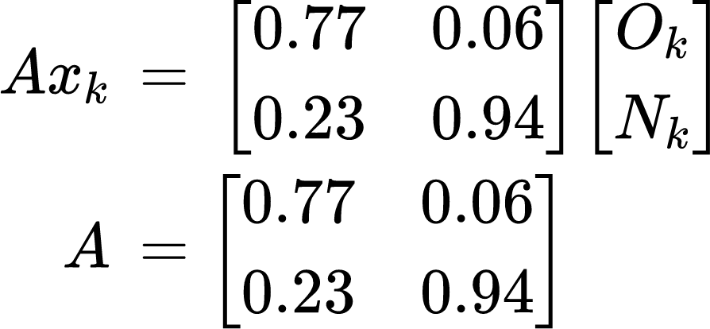
General Solutions and Eventual Ratios
Dynamic System: Age group 65+
77% remain obese, and 6% non-obese became obese the following year.
94% remain non-obese, and 23% obese became non-obese the following year.
General Solution:
Eigenvalues:
Eigenvectors:
for k >= 0

Slide 20
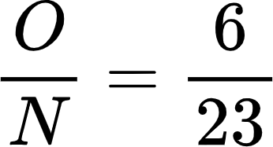
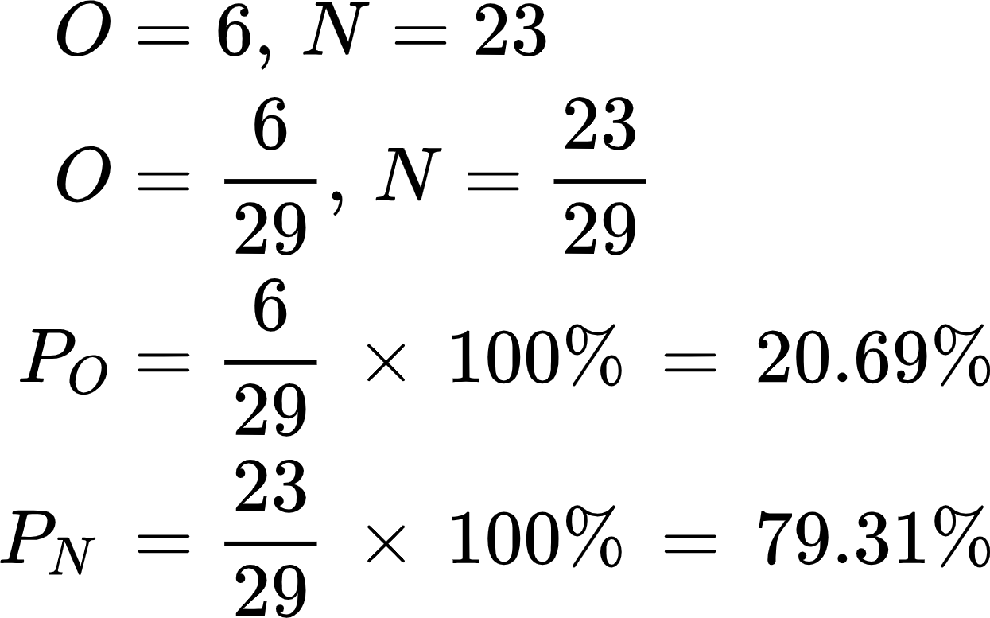
General Solutions and Eventual Ratios
Dynamic System: Age group 65+
Eventual ratio of obese to non-obese people:
as k→∞,
for every 6 obese people, there are about 23 non-obese people.

Slide 21
ANALYSIS & DISCUSSION

Slide 22
Probability of obesity transitions
Not obese -> Obese
Age group 45-64 has the highest probability of becoming obese with 12%, meanwhile, age group 18-24 has the lowest probability with 3%.
Obese -> Obese
Age group 18-24 has the highest probability of staying ‘obese’ with 88% meanwhile, age group 65+ has the lowest probability with 77%.
Not obese -> Not Obese
Age group 18-24 and 25-44 have the highest probability of staying as ‘not obese’ with 97% meanwhile age group 45-64 has the lowest probability with 88%.
Obese -> Not obese
Age group 65+ has the highest probability of reducing their body weight with 23% meanwhile, age group 18-24 has the lowest probability with 12%.

Slide 23
Steady-states of Obese and Non-obese Population by Age Group
AGE GROUPS | Obese Population Steady-State (%) | Non-obese Population Steady-State (%)
18-24 | 20.00 | 80.00
25-44 | 16.70 | 83.30
45-64 | 46.15 | 53.85
65+ | 20.69 | 79.31

Slide 24
Eventual Population Ratios of obese to non-obese by age group
AGE GROUPS | Eventual Ratio (Obese : Non-obese) | Eventual Obese Population (%) | Eventual Non-obese Population (%)
18-24 | 1 : 4 | 20.00 | 80.00
25-44 | 1 : 5 | 16.70 | 83.30
45-64 | 6 : 7 | 46.15 | 53.85
65+ | 6 : 23 | 20.69 | 79.31

Slide 25
CONCLUSION part 1
The Markov Chain and the Eigenvalues Dynamic System techniques have been effective in the development as it has satisfied all the project's objectives
The age group of 45 to 64 should pay extra attention to their health because they are the riskiest group to become obese.
Obese individuals aged 18 to 24 and 25 to 44 also must consider adopting a better lifestyle to guarantee their health in the future.
Those who are not obese are unlikely to become obese which are age group of 25 to 44.
Individuals aged 65 and above have the highest probability of losing weight over time
From the calculation of the steady-states and eventual ratios, people with the age group of 18 to 24 and 25 to 44 who are considered young are expected to stay non-obese.
Meanwhile, for people aged 45 to 64, there is more probability to see them as non-obese in the long run.
Lastly, people with the age group of 65 above are expected to stay non-obese
Nevertheless, every age group, regardless of whether they are in a high-risk category or not, should pay close attention to their health and nutrition starting from now.

Slide 26
CONCLUSION part 2
To improve the accuracy of these predictions, especially when applying the Eigenvalues Dynamic System technique, is to also collect the population percentage of obese and non-obese people in the following years of 2015 and more
The data collection will allow us to find the average growth rate of the population by year, which we can use to construct a better stage-matrix for building the general solution of how the population changes stages overtime
However, as muslims in Islam, we must not rely entirely on predictions and should keep in mind to only refer to these results as a precaution for our health. From Surah Tawba, verse 51 in the Holy Qur’an, “Say: ‘Nothing shall ever happen to us except what Allah has ordained for us. He is our Protector.’ And in Allah let the believers put their trust”.

Slide 27
Thank You!

